Slide 1
Completing the Self Study Report July 23, 2020

Slide 2
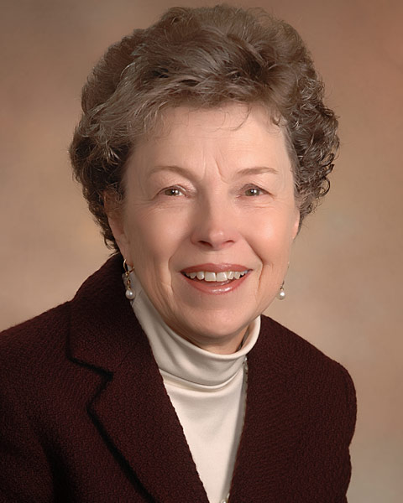
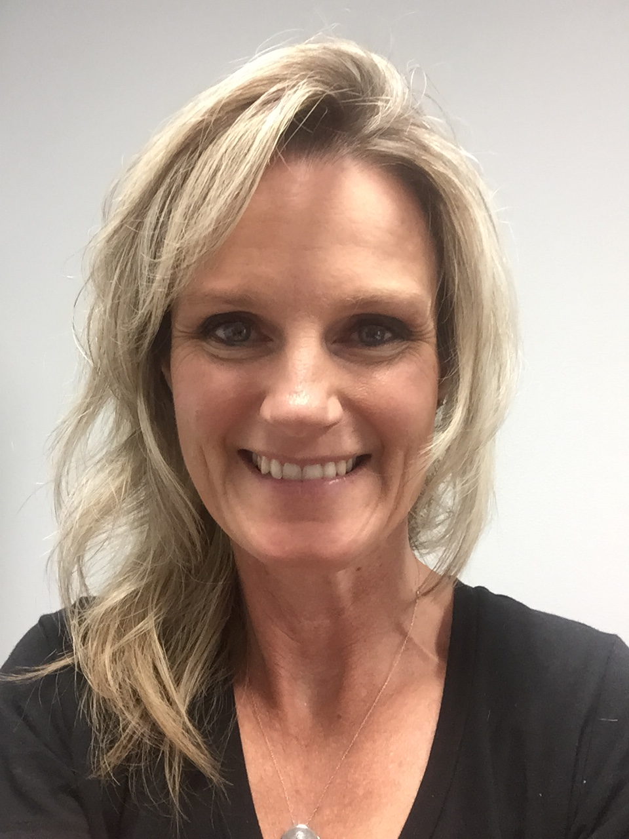
The Voices
Jennifer Anderson Warwick
Accreditation Consultant
Patricia Tritt
Day Job: Director of Instruction, AMR Learning
Volunteer Role: Past Board Member
Lisa Collard, AS
Accreditation Services Specialist
Notes:
Jennifer will start the webinar with
a general welcome
housekeeping items
everyone is on mute
webinar is being recorded and may be posted at a later date (depending on quality of recording)
introducing the moderators and facilitators, i.e., the voices
instructing attendees how to ask questions

Slide 3
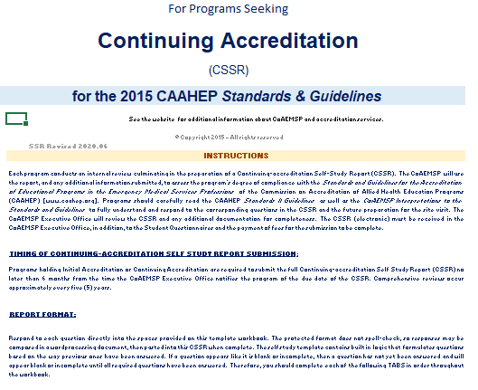

Slide 4
Process
Email notification 6 months prior to due date
ISSR due to no later than 6 months after on-time graduation of the LoR cohort
Includes a link to the CoA website
Select the correct SSR
Electronic submission

Slide 5
Process
Link to the Student Questionnaire
SSR format
Excel and supporting documentation is attached as a PDF

Slide 6
Process
Protected format does not spell check
Built-in logic formulates questions based on how previous question was answered
Complete tabs in order for the logic to work

Slide 7
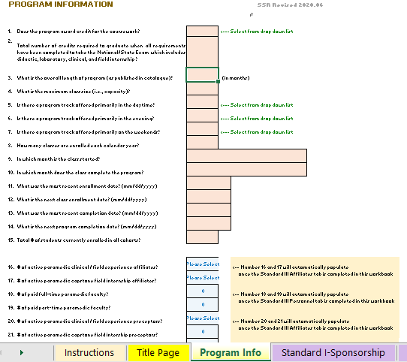

Slide 9
Step by step instructions
Do not use a collaborative cloud-based system
Save often
Scan all documents: no rotation
File is zipped, uploaded to the CoAEMSP file share
Invoice arrives from CoAEMSP and send at the time of submission

Slide 10
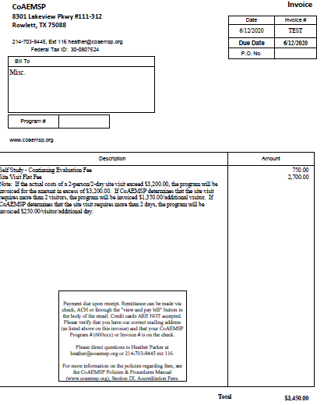
Invoice

Slide 11
Tips
Red triangle in a cell: hover and text/instructions are revealed
Folder on hard drive or program shared drive not the cloud
Place the Excel SSR in the folder

Slide 12
Tips
Folder for supporting documentation
Sub-folders for each tab

Slide 13
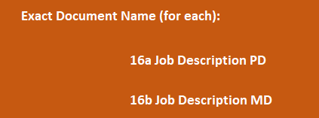
Tips
Number of supporting documents vary
If using sub-folders, move to the ‘documentation’ folder for final submission
Label all documents with the exact name as specified in the SSR

Slide 14
Tabs

Slide 15
Getting Started
Begin when the notification email arrives
Review the entire SSR and the requested documentation
Download Getting Started: an Action Plan for CAAHEP Accreditation and establish due dates

Slide 17
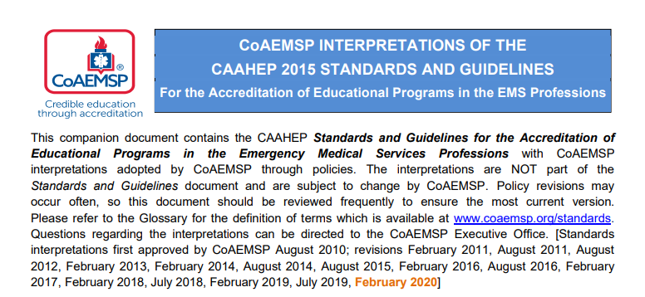
Getting Started
Review Standards and Interpretations document

Slide 18
Getting Started
Discuss the information needed with staff and Medical Director
Assign activities as need

Slide 19
Getting Started
Schedule dedicated time to work on completing the SSR
Allow adequate time for review by management team/dean
Proof multiple times for content, completeness, and accuracy

Slide 20
Common errors
Working in a cloud sharing environment
Not naming documents exactly as specified
Not reviewing documents for correct portrait orientation
Poor scan quality

Slide 21
Need help?
Lisa Collard
Lisa@coaemsp.org
214-703-8445, ext 118

Slide 22
Accreditation is an everyday activity!

