Slide 1


Frequent Citations and How to Address Them in Advance
Speaker: Patricia L. Tritt, RN, MA
Moderator: Jennifer Anderson Warwick, MA
Jennifer Anderson Warwick
Accreditation Consultant
Patricia Tritt
Day Job: Director of Instruction, AMR Learning
Volunteer Role:
Past Board Member
Notes:
JENNIFER

Slide 2
Ways to Participate
Have a question? Type it in the Question & Answer window:
Open the Q&A window.
Type your question into the Q&A box. Click Send.
The host will reply back either via text in the Q&A window or will answer your question live.
Have a Best Practice? Type it in the Chat window
Open the Chat window.
Type your best practice. Tap Enter on keyboard.
Notes:
JENNIFER

Slide 3

Do you meet the standard?
What is the evidence?
Prepare for success
There’s a form for that!
…it’s the right thing to do!
Notes:
MIKE

Slide 4
Levels of Complexity
Foundational
Process related
Easily addressed

Slide 5



Slide 6



Citations
To Program from site visit
CoAEMSP Board deliberation
To CAAHEP from CoAEMSP Board deliberation

Slide 7
2019 Summary of CAAHEP Citations
115 total actions
19 initial – 11 with citations (58%)
94 continuing – 45 with citations (48%)
2 probation
Total with citations – 58 (50%)

Slide 8
115 Total Actions

Slide 9
2019 Summary of CAAHEP Citations
Average number of citations per program
  Initial = 3
  Continuing = 2
  Probation = 3

Slide 10
Standards
I. Sponsorship
II. Program Goals
III. Resources
IV. Student and Graduate Evaluation/Assessment
V. Fair Practices

Slide 11

What do you think is the most frequent or common issue that results in a Standards citation?

Slide 12

Citations by Frequency
#1 Medical Director
Note: Total of 37 citations
III.B.3.a Medical Director Responsibilities
The Medical Director must be responsible for medical oversight of the program and must:

Slide 13
#1 Medical Director
Review progress of each student throughout the program and assist in the determination of appropriate corrective measures when necessary
Total = 11
    Initial = 2
    Continuing = 9

Slide 14
#1 Medical Director
Review and approve the instruments and processes used to evaluate students in didactic, laboratory, clinical, and field internship
Total = 8
  Initial = 1
  Continuing = 7

Slide 15
#1 Medical Director
Review and approve the educational content of the program curriculum for appropriateness, medical accuracy, and reflection of current evidence informed prehospital or emergency care practice
Total = 6
  Initial = 0
  Continuing = 6

Slide 16
#1 Medical Director
Ensure competence of each graduate of the program in the cognitive, psychomotor, and affective domains
Total = 6
  Initial = 1
  Continuing = 4
  Probation = 1

Slide 17
#1 Medical Director
Other
  Review and approve required minimum numbers for each of the required patient contacts and procedures
  Ensure educational interaction of physicians with students

Slide 18
Citations by Frequency
#2 Program Director
III.B.1.a. Program Director Responsibilities
  The Program Director must be responsible for all aspects of the programs, including, but not limited to:
  Note: total of 28 citations

Slide 19
#2 Program Director
Orientation/training and supervision of clinical and field internship preceptors
Total = 16
  Initial = 4
  Continuing = 11
  Probation = 1

Slide 20
#2 Program Director
Other
  Administration, organization, and supervision of the educational program
  Continuous quality review and improvement of the educational program
  Long range planning and ongoing development of the program

Slide 21
#2 Program Director
Cooperative involvement with the Medical Director
Effectiveness and quality of fulfillment of responsibilities delegated to another qualified individual

Slide 22
Citations by Frequency
#3 Student Evaluation
IV.A.1 Student Evaluation Frequency and Purpose
Evaluation of students must be conducted on a recurrent basis and with sufficient frequency to provide both the students and program faculty with valid and timely indications of the students’ progress towards and achievement of competencies and learning domains stated in the curriculum. Achievement of the program competencies must be assessed by criterion-referenced, summative, comprehensive final evaluations in all learning domains

Slide 23
#3 Student Evaluation
  Total = 25
  Initial = 7
  Continuing = 17
  Probation = 1

Slide 24
Citations by Frequency
#4 Student Evaluation
IV.A.2.b Student Evaluation Documentation
The program must track and document that each student successfully meets each of the program established minimum patient/skill requirements for the appropriate exit point according to patient age-range, chief complaint, and interventions

Slide 25
#4 Student Evaluation
  Total = 12
  Initial = 5
  Continuing = 7

Slide 26
Citations by Frequency
#5 Curriculum
III.C.1 Curriculum
The curriculum must ensure the achievement of program goals and learning domains. Instruction must be an appropriate sequence of classroom, laboratory, clinical/field experience, and field internship activities. Progression of learning must be didactic/laboratory integrated with or followed by clinical/field experience followed by the capstone field internship, which must occur after all core didactic, laboratory, and clinical experience. Instruction must be based on clearly written course syllabi that include course description, course objectives, methods of evaluation, topic outline, and competencies required for graduation. The program must demonstrate by comparison that the curriculum offered meets or exceeds the content and competency of the latest edition of the National EMS Education Standards

Slide 27
#5 Curriculum
  Total = 8
  Initial = 0
  Continuing = 8

Slide 28
Citations by Frequency
#6 Student Evaluation
IV.A.2.a Student Evaluation Documentation
Records of student evaluations must be maintained in sufficient detail to document learning progress and achievements, including all program required minimum competencies in all learning domains in the didactic, laboratory, clinical and field experience/internship phases of the program.

Slide 29
#6 Student Evaluation
  Total = 7
  Initial = 1
  Continuing = 5
  Probation = 1

Slide 30
Citations by Frequency
#7 Resource Assessment
III.D Resource Assessment
The program must, at least annually, assess the appropriateness and effectiveness of the resources described in these Standards. The program must include results of resource assessment from at least students, faculty, medical director(s), and advisory committee using the CoAEMSP resource assessment tools. The results of resource assessment must be the basis for ongoing planning and appropriate change. An action plan must be developed when deficiencies are identified in the program resources. Implementation of the action plan must be documented and results measured by ongoing resource assessment.

Slide 31
#7 Resource Assessment
  Total = 6
  Initial = 1
  Continuing = 4
  Probation = 1

Slide 32
#7 Publications and Disclosures
V.A.2 Publications and disclosures
At least the following must be made known to all applicants and students: the sponsor’s institutional and programmatic accreditation status as well as the name, mailing address, web site address, and phone number of the accrediting agencies; admissions policies and practices, including technical standards (when used); policies on advanced placement, transfer of credits, and credits for experiential learning; number of credits required for completion of the program; tuition/fees and other costs required to complete the program; policies and processes for withdrawal and for refunds of tuition/fees.

Slide 33
#7 Publications and Disclosures
  Total = 6
  Initial = 1
  Continuing = 5

Slide 34
Citations by Frequency
#8 Hospital/Clinical/Field Affiliations
III.A.2. Hospital/Clinical Affiliations and Field Internship Affiliations
For all affiliations, students must have access to adequate numbers of patients, proportionally distributed by age-range, chief complaint and interventions in the delivery of emergency care appropriate to the level of Emergency Medical Profession(s) for which the training is being offered…

Slide 35
#8 Hospital/Clinical/Field Affiliations
…The clinical/field experience/internship resources must ensure exposure to, and management of, the following patients and conditions (see Student Minimum Competency Matrix, aka Appendix G)

Slide 36
#8 Hospital/Clinical/Field Affiliations
  Total = 5
  Initial = 1
  Continuing = 4

Slide 37
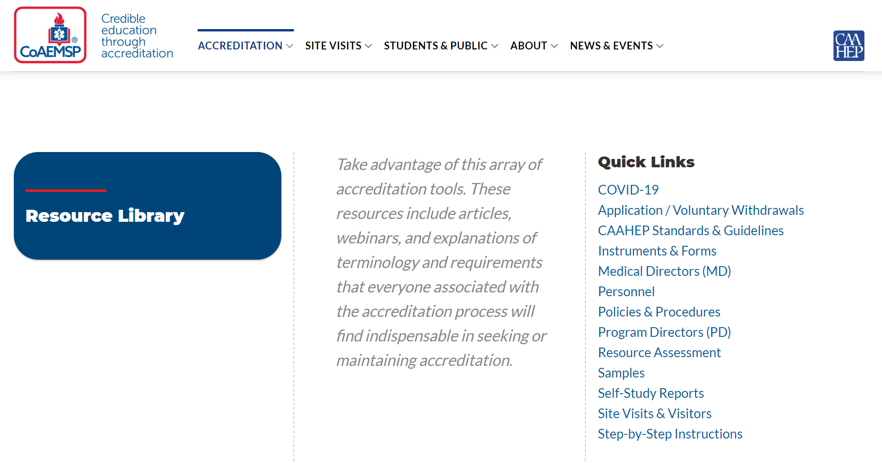

Slide 38

Notes:
Jennifer will manage the Questions and will direct each question to a specific person.

