Slide 1
From Findings to Follow-Through: Strategies for Successfully Preparing a Progress Report
Mike Miller, EdD, RN, NRP

Slide 2
Topics of Conversation
Review CoAEMSP policy
What is a progress report?
Reasons for progress reports
Strategies for preparing a progress report
Review some examples

Slide 3

Audience Poll
How many Program Directors? Deans? Others?
How many of you have never prepared a Progress Report?
How many of you are in the process or will soon be preparing Progress Report?

Slide 4
CoAEMSP Policy IV.B. – Progress Reports
“Accredited programs may be required to submit one (1) or more Progress Reports to document compliance with the CAAHEP Standards. After the second Progress Report, failure to meet a standard or to make significant progress in addressing a citation by the stated deadline may lead to an adverse accreditation action (e.g., Probationary Accreditation).” (p. 26).

Slide 5

What is a Progress Report?

Slide 6
What is a Progress Report?
Request for information to demonstrate a program is actively addressing areas where it was previously found to be deficient in meeting accreditation standards
Opportunity to submit evidence of “progress”
Self-reflection tool designed to promote continuous improvement
Demonstrates program meets accreditation Standards & policies
Making progress and demonstrating Standards are being met allows the program to maintain its accreditation status

Slide 7

Reasons for Progress Reports
Any area of standards deficiency may result in a request for a progress report

Slide 8
Examples

Slide 9
II.B. Program Goals: Advisory Committee
“The program advisory committee must include at least one representative of each community of interest and must meet annually. Communities of interest served by the program include, but are not limited to, students, graduates, faculty members, sponsor administrators, employers, physicians, and the public.”
Rationale:
“There has not been a currently enrolled student on the advisory committee as evidenced by review of meeting minutes, and discussion with current advisory committee members, current students, and graduates for at least 3 years.”

Slide 10
III.B.9. Resources: Clinical Affiliates
“Program resources must be sufficient to ensure the achievement of the program’s goals and outcomes.” [9. Clinical affiliates]
Rationale:
“Students report limited access to clinical affiliation sites, expressing they may wait several weeks to be scheduled and that it delays their on-time graduation. Review of two of the three affiliation agreements indicates they expired a year ago and the program indicates they have not taken steps to renew the agreements.”

Slide 11
III.D. Resources: Resource Assessment
“The program must, at least annually, assess the appropriateness and effectiveness of the resources described in these Standards. The results of the resource assessment must be the basis for ongoing planning and change. An action plan must be developed when needed improvements are identified in the program resources. Implementation of the action plan must be documented, and results measured by ongoing resource assessment.”
Rationale:
“There is no evidence the program conducted an annual resource assessment in 2024, with the most recent resource assessment conducted in March of 2023.”

Slide 12
IV.A.1. Student & Graduate Evaluation/Assessment: Student Evaluation – Frequency & Purpose
“Evaluation of students must be conducted on a recurrent basis and with sufficient frequency to provide both the students and program faculty with valid and timely indications of the students’ progress toward and achievement of the curriculum competencies in the required learning domains.”
Rationale:
“Students convey they complete frequent quizzes and written exams. However, in the simulation laboratory and during clinical shifts feedback is inconsistent and there is no formal report on students’ progress toward meeting patient care competencies. Recent graduates report this was also their experience.”

Slide 13
V.A.2..f. Fair Practices: Publications & Disclosure
“At least the following must be made known to all applicants and students: f. Policies on advanced placement, transfer of credits and credits for experiential learning.”
Rationale:
“There is no evidence following review of the catalog, program policies, and student handbook of a policy on advanced placement.”

Slide 14
What tips do you have for preparing a progress report?

Slide 15
Tips for preparing Progress Reports (1/3)
Read carefully and follow the instructions
If you have questions seek guidance and clarification
Provide what is being requested – nothing more and nothing less
There may be more than one item being requested – read carefully
Be transparent… If you do not have the evidence or it is in process, provide a status update

Slide 16
Tips for preparing Progress Reports (2/3)
Be sure your submission is timely
Think about the information you are providing as evidence the program has made necessary changes to demonstrate the program is meeting Standard(s)
Ask other program personnel to review the response
Remember the teams reviewing the material submitted are asking a simple question – does the evidence submitted demonstrate standard compliance?

Slide 17
Tips for preparing Progress Reports (3/3)
Blank forms is not evidence
When a sample is requested provide only the number requested, e.g., provide terminal competency forms for 3 graduates
If a policy is part of a larger document, provide only the page(s) applicable to the request
Be sure documents submitted are readable/legible, and oriented the same way
FERPA – do not redact names

Slide 18
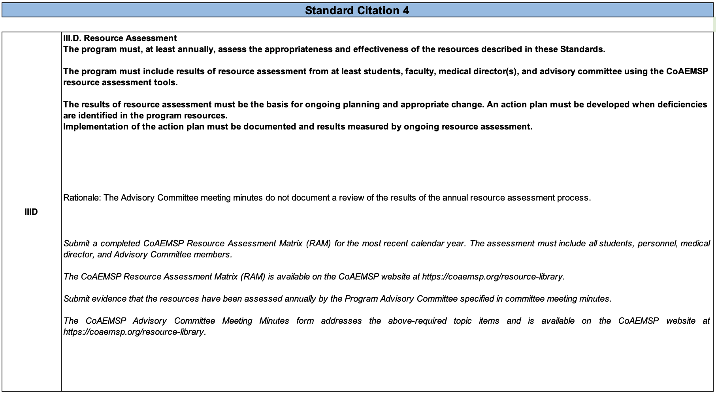
Sample Response Template

Slide 19
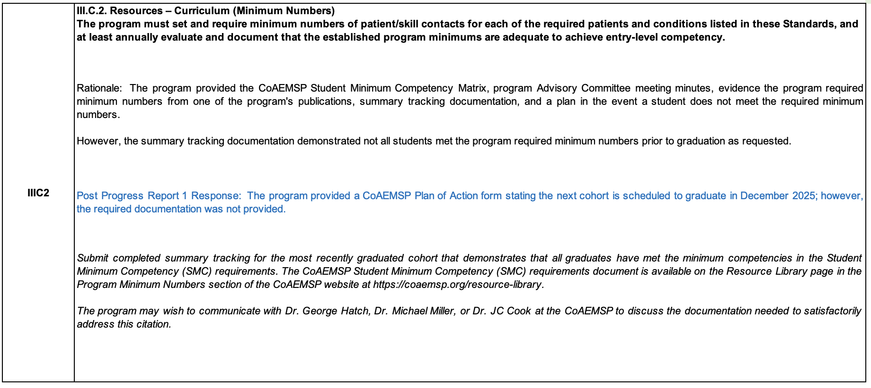
Sample Response Template

Slide 20
Formatting the Response
Develop an “Evidence” folder
Submit as a single PDF the evidence responding to each Finding
Each Finding is addressed separately
Title of each PDF is “Finding 01” or “Finding 02” and so on, corresponding to each Finding

Slide 21
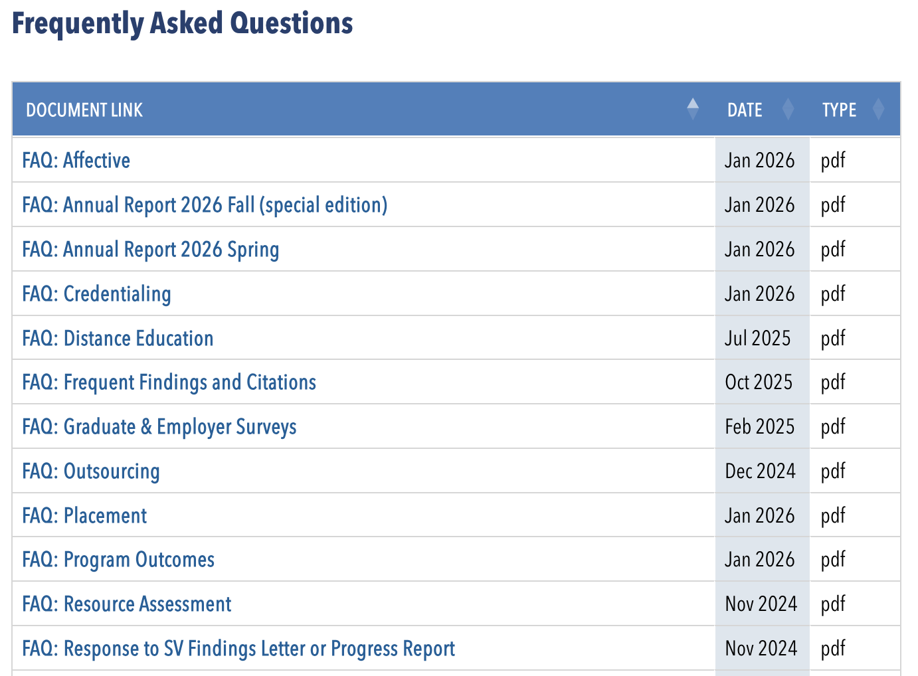
FAQ

Slide 22
Key Takeaways
[1]
[2]
[3]
Reports are a tool for you and the CoAEMSP to examine your program against the Standards
Gather & maintain key information for use when developing your reports – evidence is key
If you need assistance know the CoAEMSP is available to assist

Slide 23


